Slide 1
205, Feb 26, Class 23
Applied Research
Quasi-experimental studies: Field, Intervention, Translational research
Example: Field Research, Cunningham (1989)

Slide 2
Quasi-Experimental Research Methods
Mix of experimental and non-experimental methods
Requires at least one controlled independent variable
Field Research
Experimentation in the real world, outside of laboratory control
Intervention Research
Testing out something that may help people
Translational Research
Bringing basic science results to application

Slide 3
Training intervention with Military personnel
Can memory theory be used to accelerate training?
Intervention to speed learning
Targeted skill training
Shorter time course, 4-6 weeks
Large numbers of students, all getting identical content
Training may improve performance on key skills
How to design this ethically?

Slide 4
Philosophical Ethical Challenges
When the experimental treatment is a benefit
Justice would normally mean equal benefits across groups
Intervention research on Monday
Coercion versus voluntary participation
Authority figures: supervisors, teachers
Financial rewards: incentivizing risk
Vulnerable populations
Children: depend on guardian
Mandatory reporting training for staff
Prisoners: cannot voluntarily consent
Research must be for prisoners’ benefit

Slide 5
Crossover Intervention Design
Test 1: A1 versus B1
Test 3: A1 versus A2
A
Assessment - 1
A1 Scores, Cohort A
T3
Assessment- 2
A2 Scores, Cohort A
Intervention Training
No training
Random assignment within a single class, half students to “A” cohort and half to “B” cohort
T1
B1 Scores, Cohort B
B2 Scores, Cohort B
No training
Intervention training
B
T2
Test 2: B1 versus B2

Slide 6
Contrasts
T1: A1 > B1
Strongest evidence if successful
Cohort A is better at task performance because of training intervention
Weakest for statistical power
“Between-participants” design vulnerable to individual differences, variability due to measurement error
T2: B2 > B1
Strongest statistical power
Each student is their own control, pre/post design
Inference that intervention caused improvement is weakened by other possible sources of learning between assessments
T3: A1 = A2
Demonstrates retention
Weak statistical test relies on no difference but still useful to document

Slide 7
Intervention research
Give an example of a research study not included in the chapter for which it would be unethical to include a placebo/control group.
Why are rules requiring reporting of conflict of interest important for ensuring accurate and fair scientific processes and reports?

Slide 8
Field experiment
Cunningham (1989) trained several colleges students to approach opposite-sex bar patrons at random, delivering one of several different kinds of conversation-starters (“lines”). The positivity of each patron’s response to the line was surreptitiously measured.
Cunningham discovered that women were much more sensitive to the kind of line an opposite-sex person delivered than were men. Women responded more positively too lines that were either self-disclosing or ordinary, like a simple “Hi,” than they did to a flippantly delivered line such as “You remind me of someone I used to date” or “Bet I can outdrink you.”
Men, however, did not appear to care which kind of conversational gambit a woman used; they responded equally positively to all three.

Slide 9
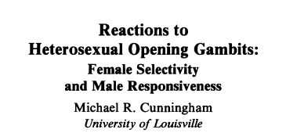
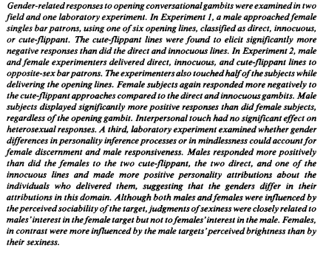


Slide 10
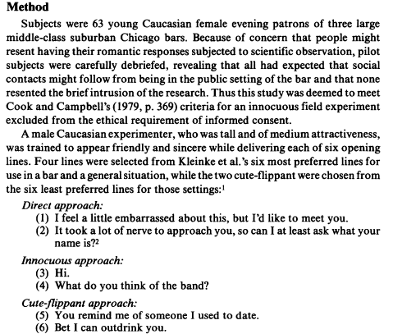
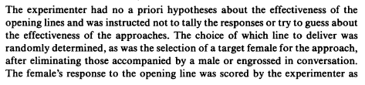
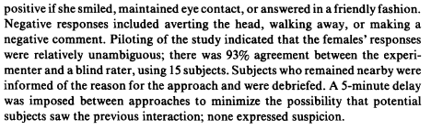
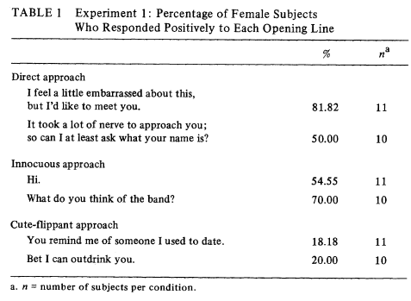

Slide 11
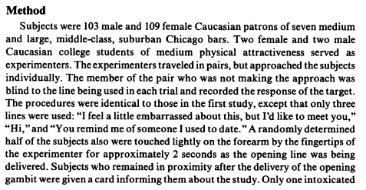
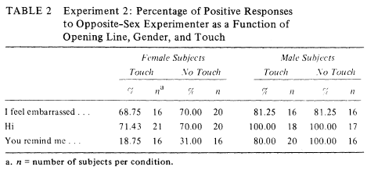

Slide 12
Field Research Procedures
Q1. The experimental report does not include information about the time of day when the data were collected for Experiments 1 or 2. One might imagine that responses to the “lines” might be different at 9pm and 1am.
Give 2 other extraneous variables that might affect the DV for these studies that should be considered in planning data collection.
Q2. How many participants total were run combined across Experiments 1 and 2? How many days/hours/trips to the bars do you think this would have taken?

Slide 13
Internal/External Validity
Q3. Experiment 3 provides a comparable procedure suitable for a well-controlled laboratory environment. How does this improve the internal validity of the results?
Q4. In what ways are Experiment 3 less effective than the field research with respect to external validity of the results?

Slide 14
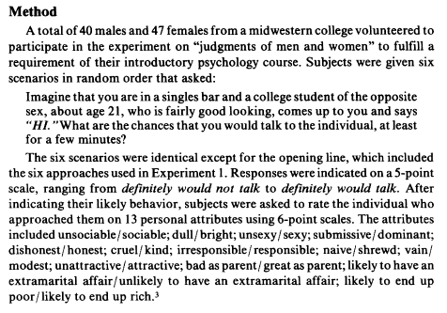
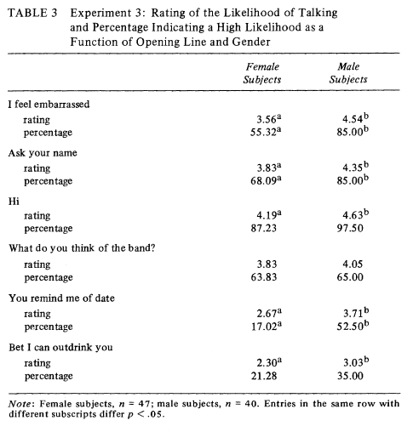

Slide 15
Q5. Experiment 1 includes the note:
“Because of concern that people might resent having their romantic responses subjected to scientific observation, pilot subjects were carefully debriefed, revealing that all had expected that social contacts might follow from being in the public setting of the bar and that non resenting the brief intrusion of the research. Thus this study was deemed to meet Cook and Campbell’s (1979, p. 369) criteria for an innocuous field experiment excluded from the ethical requirement of informed consent.”
This rational does not meet modern expectations for best practices for ethical research.
If one were to propose some similar research today, what ethical issues would you expect the IRB to raise and how might a researcher address those?

Slide 16
Field Research Summary
Quasi-experimental design
Manipulated independent variable
Done outside controlled laboratory conditions
Good external validity
Pretty good internal validity
Procedurally difficult to carry out
Many uncontrolled extraneous variables
Challenging to follow best practices for ethical research
Lack of voluntary participation, informed consent
Implicit deception

Slide 17
For Wed Feb 28
Chapter 20: Developmental and Neuropsychological Methods
Final project full proposal
Implemented procedure that we can test and verify
As soon as possible

